Slide 1
Assembling the genome of rātā Moehau and applications for other NZ Metrosideros
Ngāti Kuri
Tammy Tauroa
Wayne Petera
Sheridan Waitai
MWLR
Nat Forsdick
Rob Smissen
Thomas Buckley
Duckchul Park
Peter Heenan
Alex Verry
Connor Watson
Auckland Botanic Gardens
Emma Bodley
Jessie Prebble
Funding from Genomics Aotearoa and the BioHeritage Challenge
Notes:
Kia ora Koutou, before I start talking about assembling the genome of rātā Moehau, and applications for other New Zealand Metrosideros
I’d like to begin by sharing my pepeha:
Tena kotou katoa
Ko ahu patiki te maunga e rū nei taku ngākau
Ko whakaraupo te moana e mahea nei aku māharahara
E mihi ana ki nga tohu o nehe, Te Hapū o Ngāti Wheke, e noho nei au
No te wharau ahau
Ko Jessie Prebble taku ingoa
No reira tena kotou, tena kotou, tena tatou katoa
That recognised Ngāti Wheke as custodians of whakaraupo, Lyttelton harbour in canterbury, and introduced me as Jessie, hi!
There is another location, and iwi, that is actually the most important to acknowledge for this work though

Slide 2

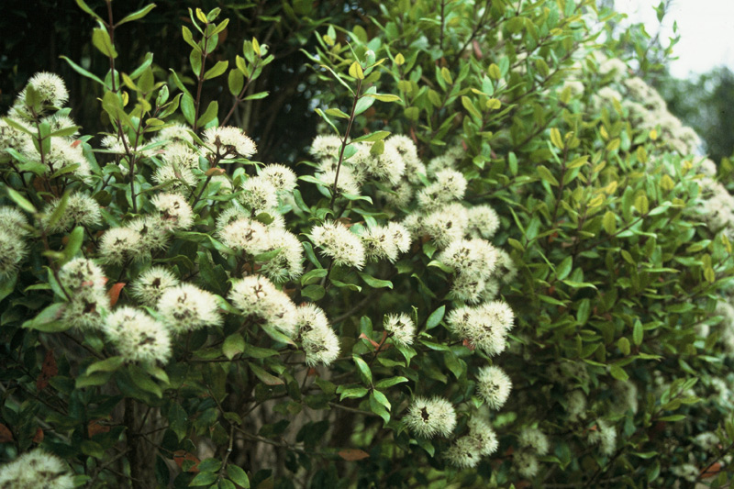
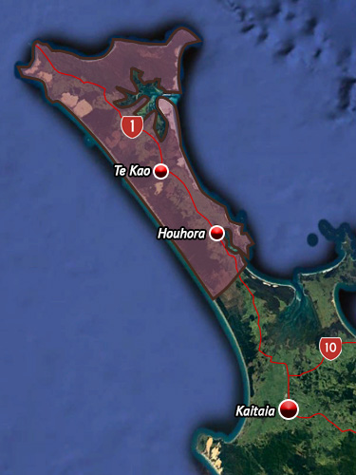
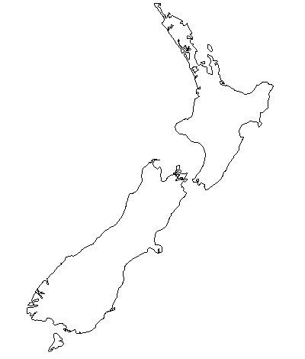
Rātā moehau
Ngāti kuri
Peter J. de Lange from NZPCN Licence: CC BY-NC.
Notes:
And that is the home of rātā Moehau, Metrosideros bartlettii, and the tribe of Ngāti kuri for whom it is a Tāonga, or treasured species. Ngāti Kuri’s rohe, or area, is the very far north of Aotearoa New Zealand, Te Tai Tokerau, and it is only by building a relationship with this iwi that the work I’m going to talk about has been possible.

Slide 3
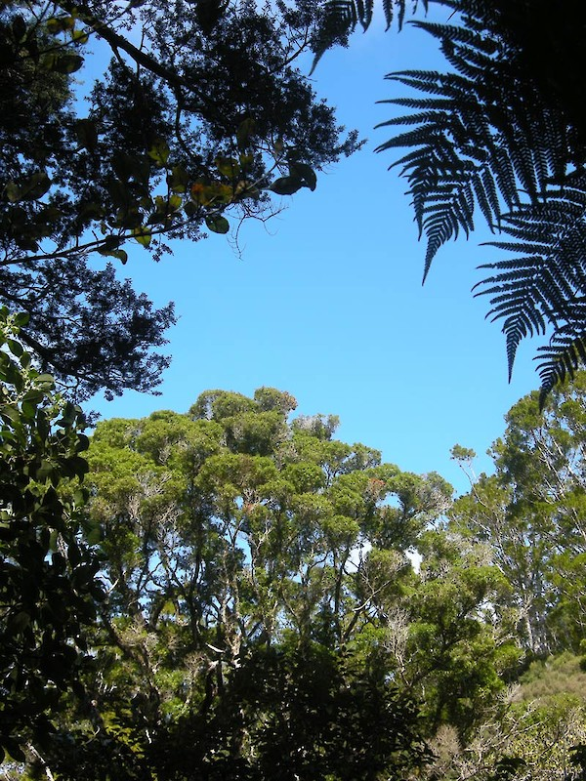
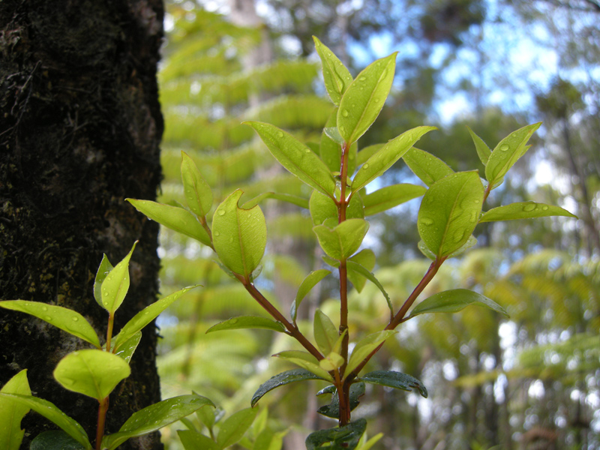
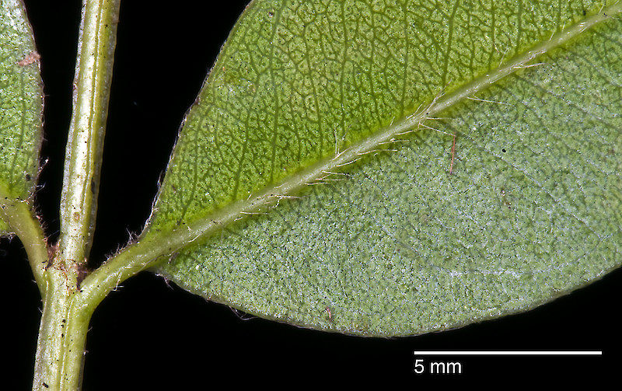
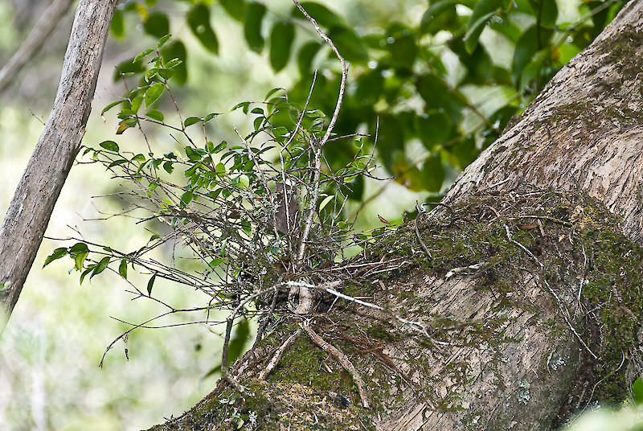
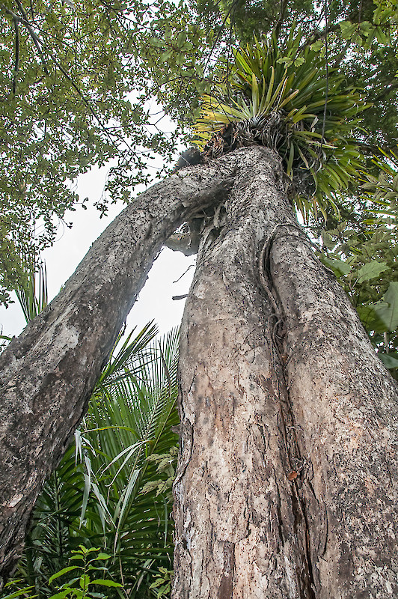
rātā Moehau
Metrosideros bartletii – Bartlett’s rata
“discovered” 1976
Described 1985
3 populations
John Sawyer, Jeremy Rolfe, Peter J. de Lange sourced from NZPCN Licence: CC BY-NC.
Notes:
Northland endemic. Taonga species of Ngāti kuri.
Only white flowered Tree Rātā, often starts life as an epiphyte, before growing into a majestic tree, and has a characteristic flakey bark.
A fairly recently described species, for a tree, only “discovered” by western science in 1976, then a bit of a delay before it was formerly described, because it took a while until the flowers were observed. This is partly due to there not being many trees, the first discovery found 7 plants, but it’s also because the tree doesn’t flower very often, neither regularly not frequently as far as we can tell. Which may in part explain why there are so few of them.

Slide 4
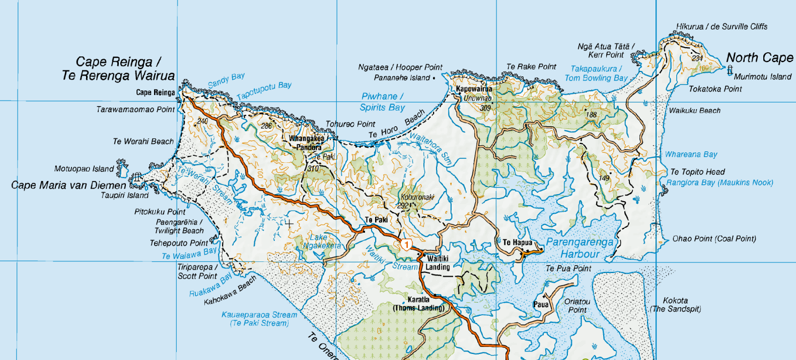
31 plants counted in 2000
22
Unuwhao
2
Kohuronaki
Radar Bush/ Te Paki
7
Notes:
Now maybe only 14 individuals (2015), don’t know what the latest numbers are

Slide 5
14 plants counted in 2015
4
Unuwhao
2
Kohuronaki
Radar Bush/ Te Paki
8
Notes:
Now maybe only 14 individuals (2015), don’t know what the latest numbers are.
I was up visiting nga`ti kuri last week and managed to get to this site, which I have now learnt the ngāti Kuri name is Tahae, and we visiting a single tall rata moehau tree, there may be two additional trees in that forest remnant but we didn’t’ manage to access them in the amount of time available.

Slide 6
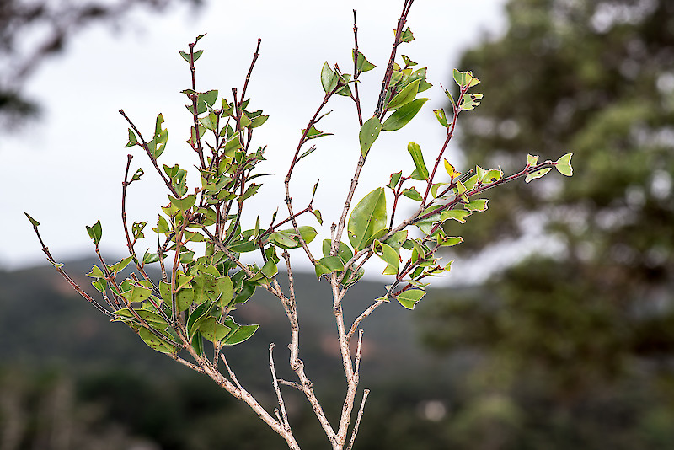
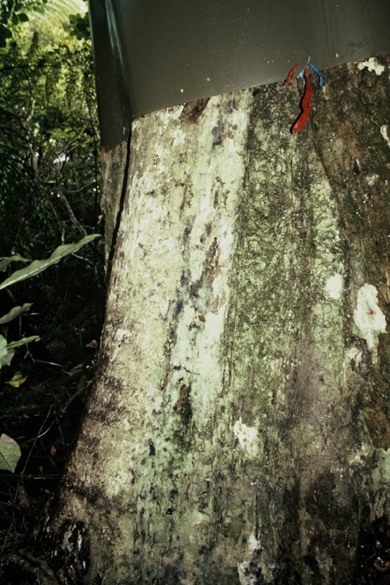
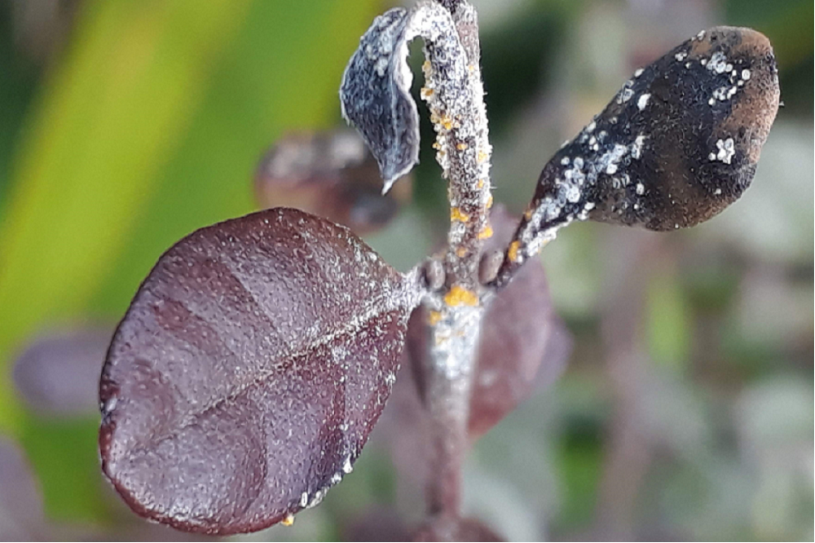
Risks
Possum browse
Habitat destruction
Myrtle rust
Jeremy Rolfe, Gillian M. Crowcroft sourced from NZPCN Licence: CC BY-NC.
Notes:
Myrtle rust first recorded in the country in 2017.
We saw a lot of dead maire tawake - Syzygium maire, and some rust on Lophomyrtus.

Slide 7
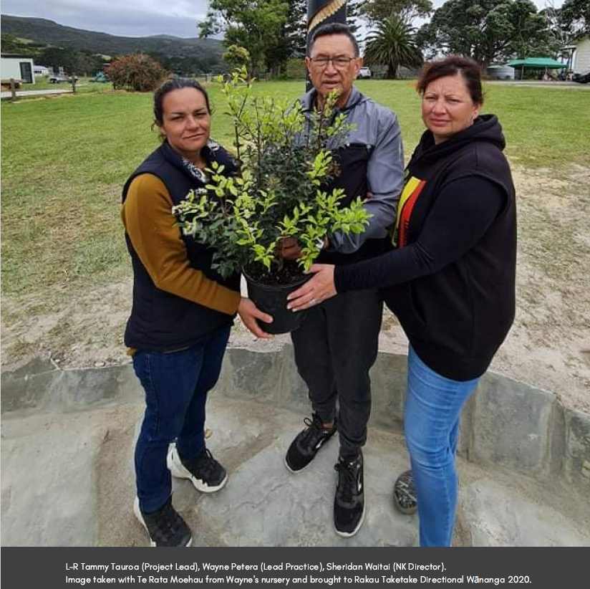
A taonga of Ngāti Kuri
Notes:
In collaboration with Ak botanic gardens and others, working on growing the plants. Developed a nursery up at te paki. The aspiration of cultivating and planting out 500 plants.
We had some funding from Genomics Aotearoa, which is an organisation with the goal of upskilling NZ researchers in assembling genomes, and due to the arrival of myrtle rust we thought that assembling the genome of one of our native myrtaceae, and probably a Metrosideros, would be useful.
So we went to Ngāti Kuri with these ideas and they were very enthusiastic about us sequencing and assembling the genome of their Taonga, rātā Moehau, they hoped it would help them learn more about the current state of its genetic diversity andh ow that is partitioned across the landscape, but they are also keen to learn how their cultivated plants relate to the wild populations, to help inform their restoration and planting plan.

Slide 8
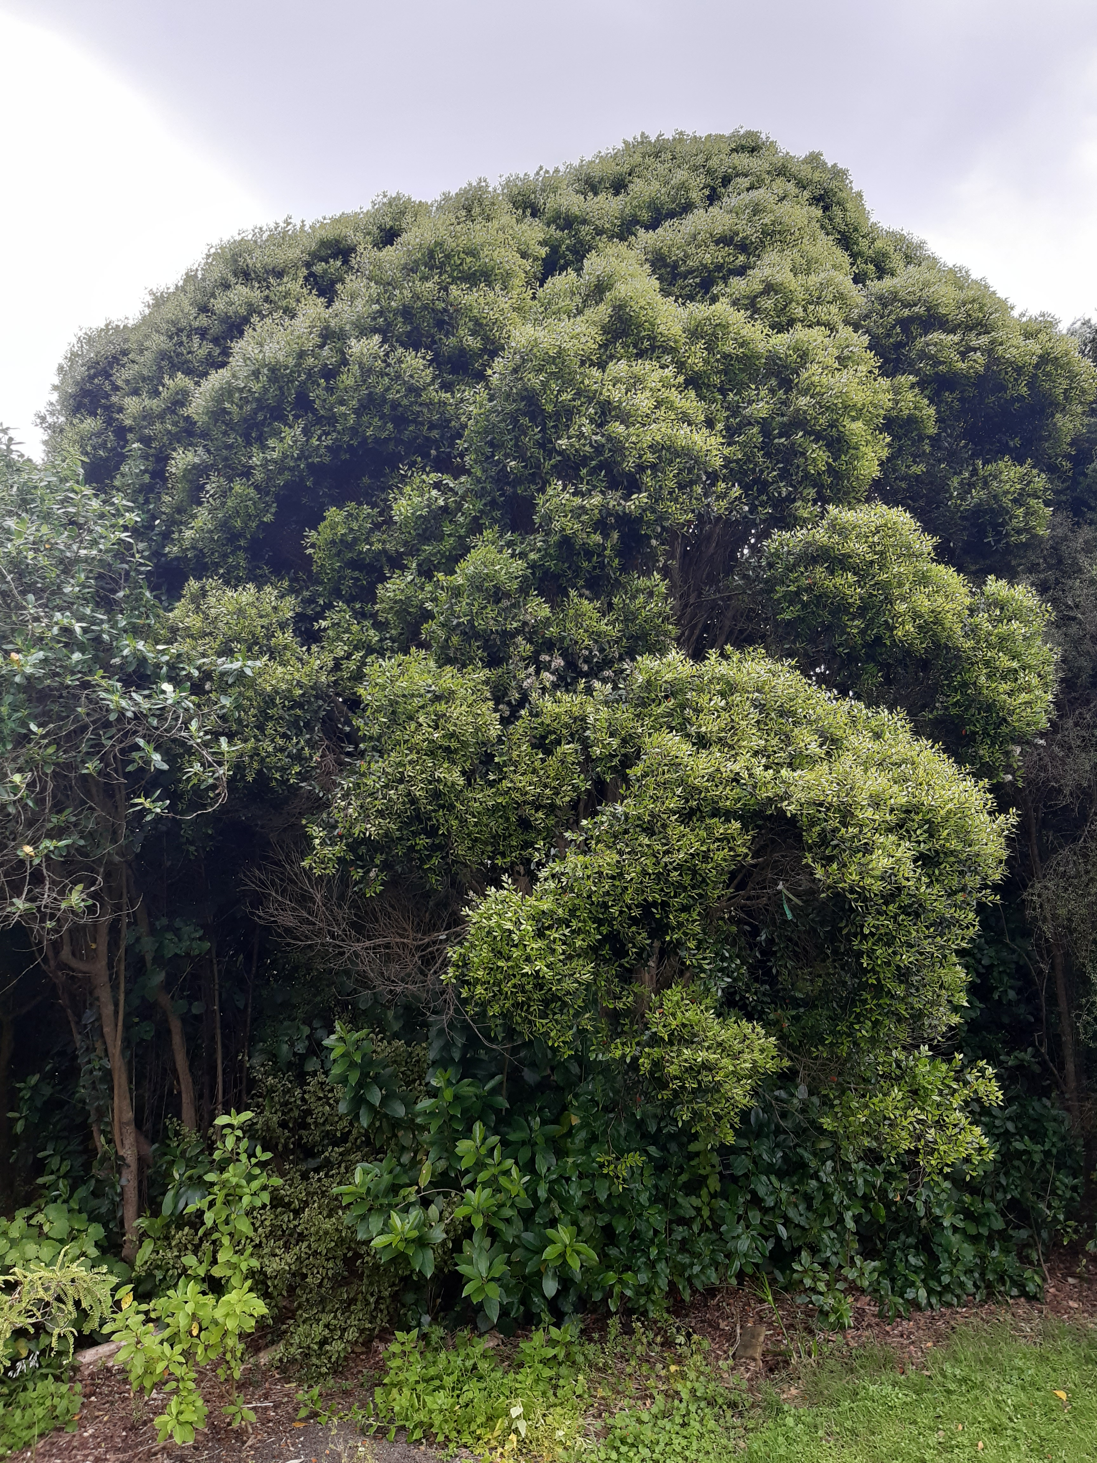
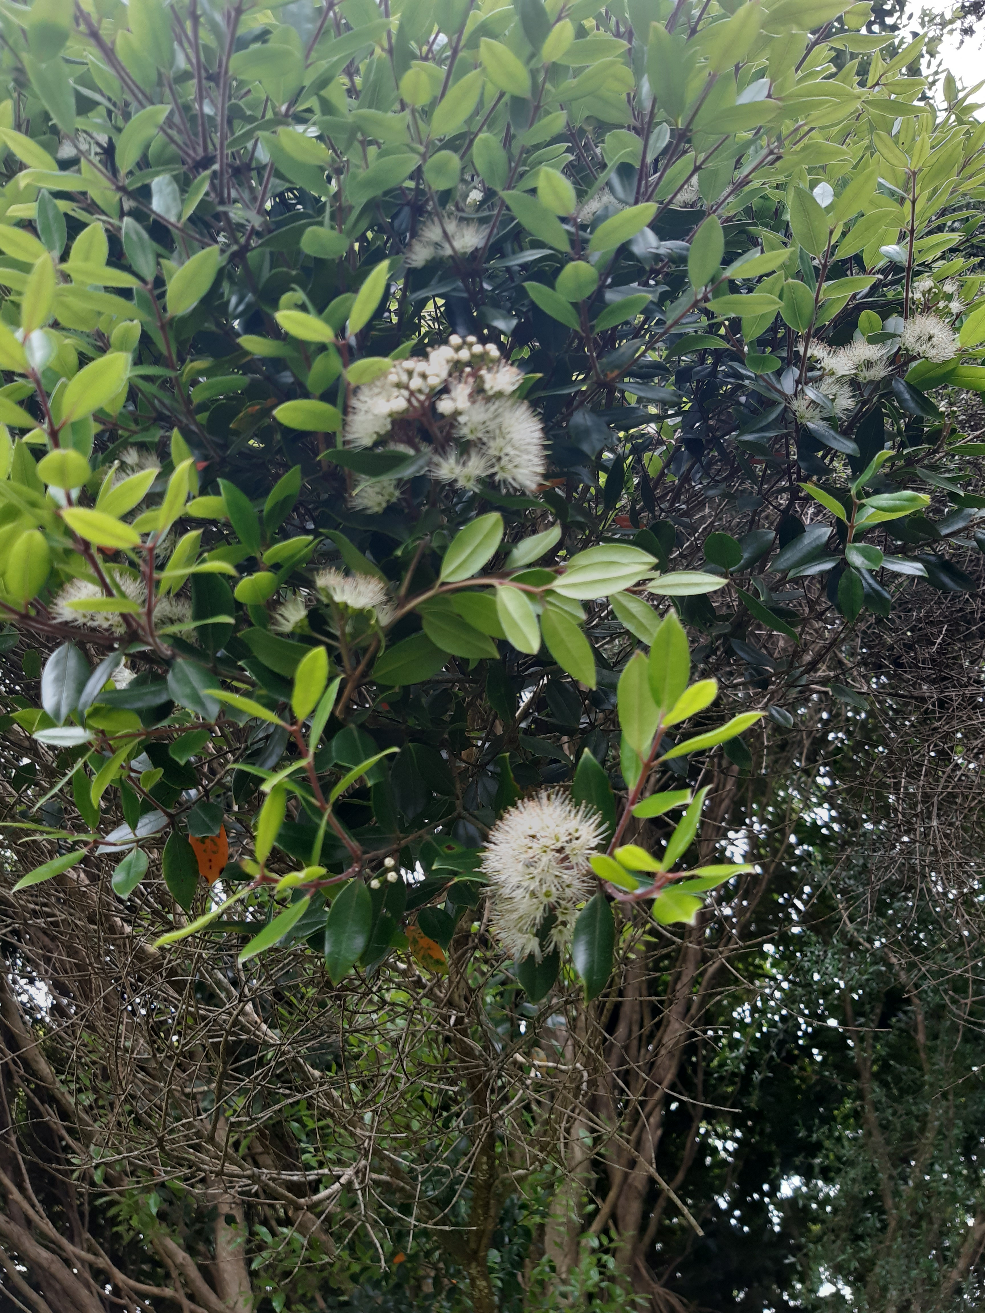
Collection day!
Auckland Botanic Gardens 16 Nov 2021
Photos by Emma Bodley, Auckland Botanic Gardens
Notes:
So, to assemble a genome you need to extract a lot of high quality nucelar DNA, so an easily accessibly plant of known provenance makes your life a lot easlier, and fortunately Auckland Botanic Gardens had the perfect contender.
Wouldn’t usually make a fuss about the exact date that samples were collected, but in this case it was memorable as it was in the middle of one of Auckland's protracted covid 19 lockdowns, and Emma had to get permission to keep checking on the plants to see if they were flowering yet, and we wanted them flowering so we could extract RNA from flowers and leaves for transcriptome sequencing to help annotate the genome.

Slide 9
Sequencing
Small genome = 350 Mb
Nuclei isolation method for DNA extraction
2x Nanopore R9.4.1 flowcells
2.6 million reads
43 Gb raw data = 125X raw depth
Read N50 = 21-30 kb
Notes:
On our side when it came to the choice of taxa for genome assemble is that Metrosideros tend to have realtively small genomes, and so although it wil sounds like we have done a huge amount of sequencing, its still a lot less than many plant genomes would need.
Firstly we extracted high quality
A lot of sequencing
Quality – at least 13% above Q15, at least 78% above Q10
Processing – porechop for adapter removal, NanoFilt removed reads shorter than 500 bp, <Q10, and trimmed lower quality head and tail of reads

Slide 10
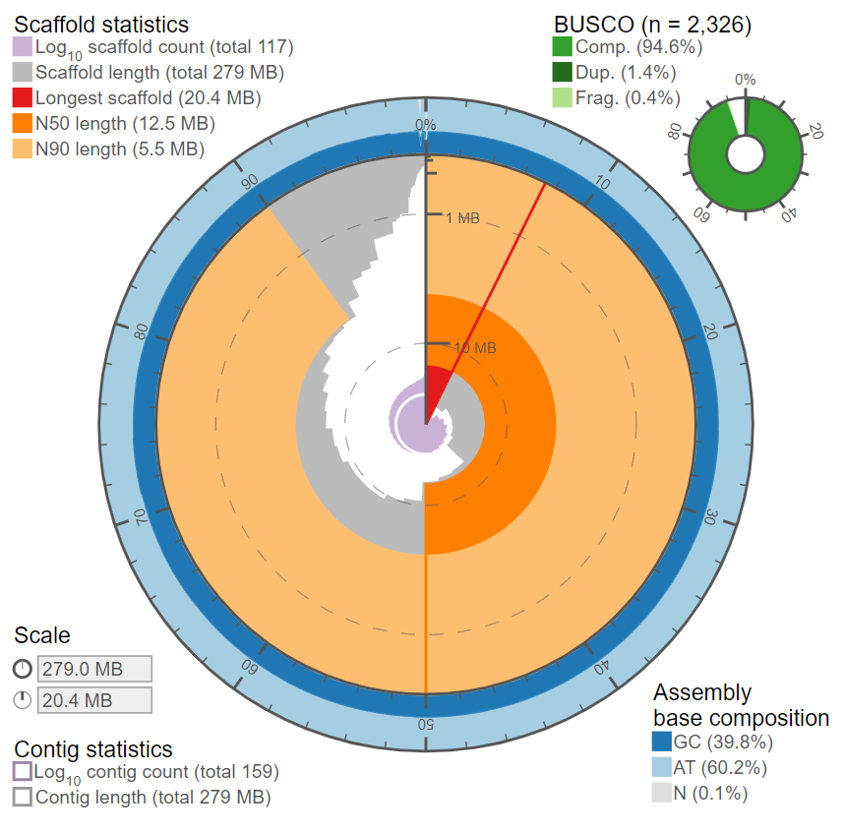
Assembly
Shasta
Notes:
Assembly: tried three assemblers: Flye v2.8.3, Raven, Shasta – Shasta looks the best for this data
Post-processing: purge_dups, long-read scaffolding (LRScaf/LongStitch), TGSGapCloser
This graph is showing how the sequences are assembled into contigs, also called scaffolds, which when all is going well are the same thing as chromosomes, so here it is showing we have 117 fragments rather than 11, but the large proportion of the sequences are actually in long scaffolds, with a tail of shorter unassmebled fragments, so to those not used to looking at such graphs this is actually showing a pretty good assembly already. The BUSCO scores stands for “bench marking universal single-copy orthologs scores, which look for the presence of absence of highly conserved genes in the assembly, and again a score of 94.6 would be considered good for completeness, and there are a fairly low number duplicated.
But we didn’t stop there

Slide 11
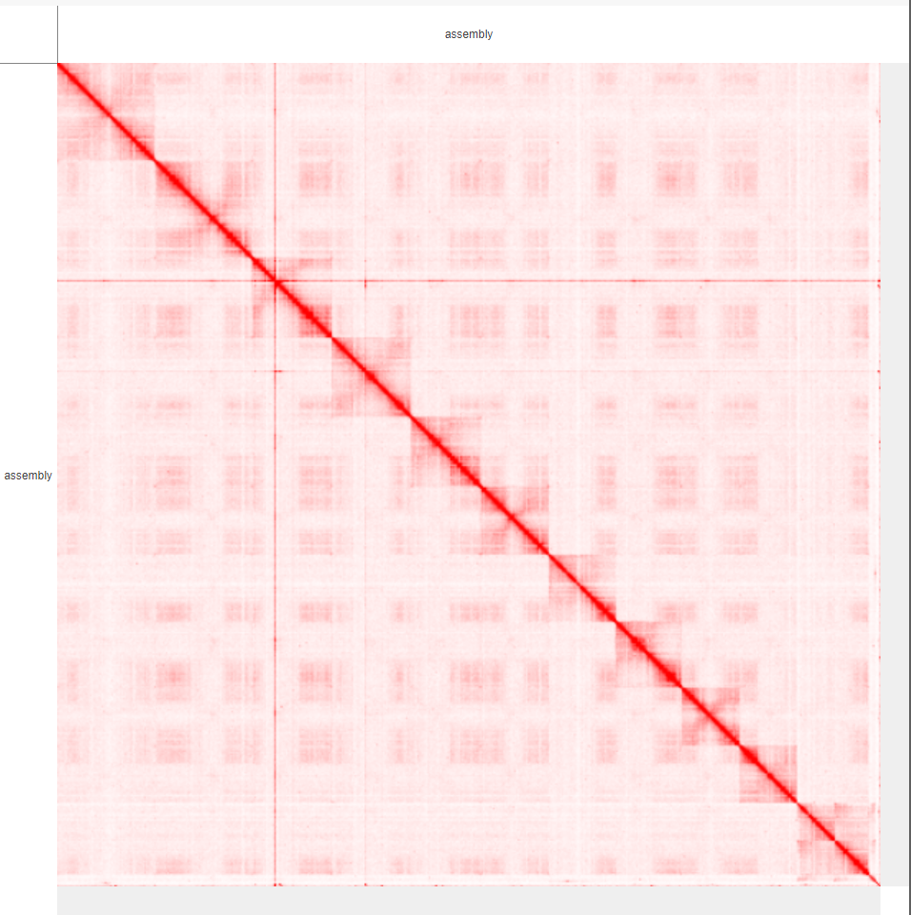
Scaffolding
Omni-C sequencing
Notes:
We did some more sequencing, Omni-C, or Hi-C sequencing to be precise.
Hi-C is essentially a technique to measure the frequency at which two DNA fragments physically associate, this is done by fixing the chromatin structure that the DNA is in in the nucleus with formaldehyde, fragmenting (digesting), biotin labelling chimeras, and then sequencing those. This data can be used to help scaffold the assembly into chromosomes based on the proximity information these chimeras yield.
This is showing a contact map, showing the intensity of the physicial interaction between two genome regions,

Slide 12
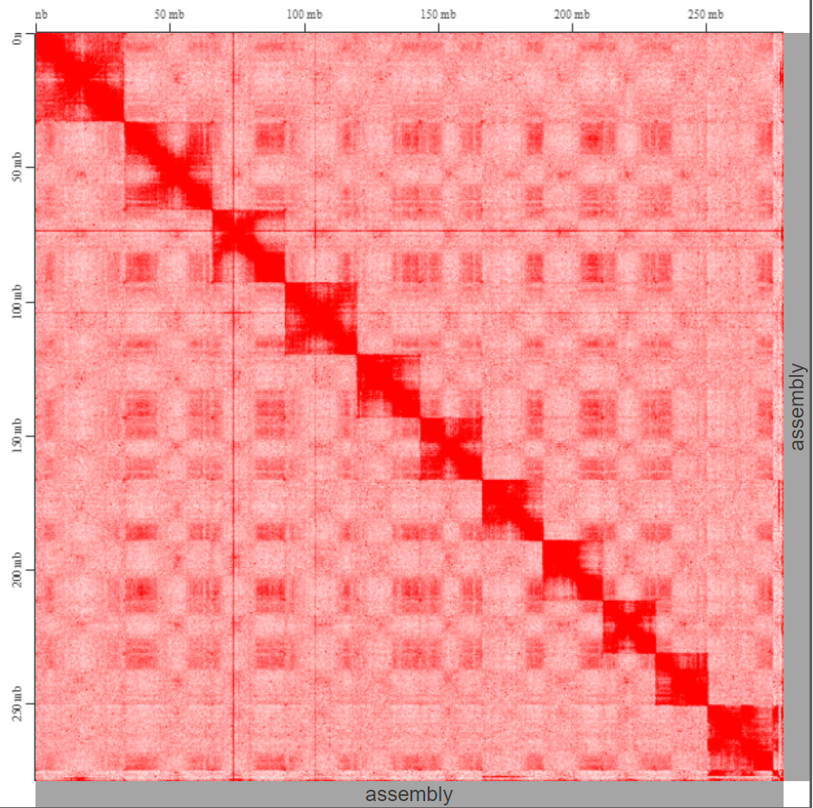
Chromosomes!
1
2
3
4
5
6
7
8
9
10
11
Notes:
and if we beef up the normalisation score you can more clearly see that although there is some noise still in our assembly, for them most part the sequences are now assembling into these blocks, of which there are 11, which is conveniently the number of chromosomes we were expecting and hoping to recover!

Slide 13
What next?
For the genome?
Why did we want to assemble this genome?
Notes:
Polish – illumina sequencing, better accuracy than nanopore
Annotate the genome - RNA sequencing from flowers and leaves
Bigger question, why did we want to sequence this genome anyway?
And actually this project has a slightly convoluted origin story, that started with funding from genomics Aotearoa, who are an organisation with the goal of upskilling new zealand researchers in genome assembly (among other things), and the funding came with the directive to find a species to work on, build a relationship with a relevant iwi, and find co-funding to actually do something with the genome once it is assembled.
We had already identified that with the arrival of myrtle rust in new zealand we have quite a gap in out knowledge about the population genetics of almost all of our native myrtles, which would be a first step to figuring out how they may respond to the threat, whether there are certain populations that might be more at risk, or more worth preserving, and the biological challenge agreed we could use some fund for pop gen work once we got a genome.
I already have a fairly good relationships with Ngāti Kuri, so went to them to ask what they would like us to work on. They have quite a few myrtles growing in their rohe, including 8 Metrosideros (there are 12 in NZ), and two that they consider Taonga species, rata Moehau and kahika Rangiathua from Raoul Island - the Kermadecs. Rātā Moehau was not initially an obvious contender to me, as I knew how rare and special it was, plus it is one of the few species that actually has some genetic work done on it already. But, that is the one that Ngāti Kuri asked us to focus on, and actually I think it has worked out really well.
Re-sequence wild rātā Moehau samples

Slide 14
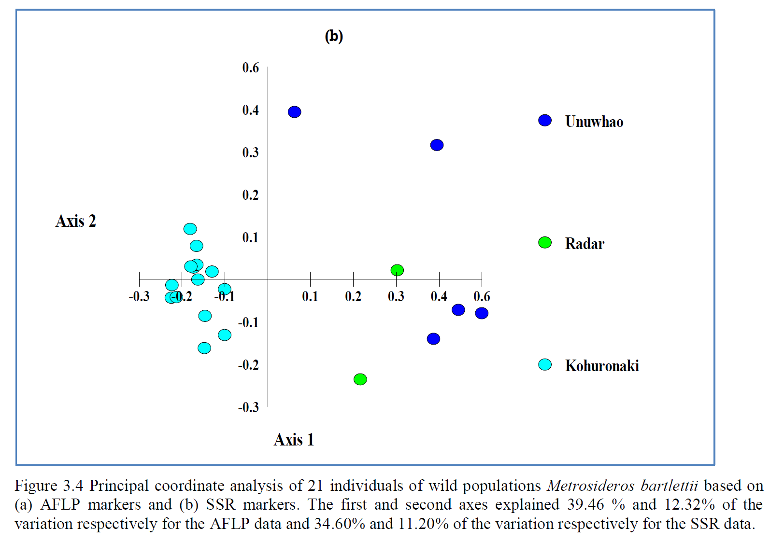
What next?
Resequencing rātā moehau samples
Kumilign Melesse PhD Thesis completed 2017
SSR and AFLP data
Notes:
Proposing to resequence all available material
This would give a complete picture of genetic diversity and whakapapa for the species, as this sampling includes 9 of 14 original trees growing in the wild
Resequencing is a more comprehensive DNA sequencing method than those used previously on rātā moehau, which would allow us to undertake demographic analyses which can tell us more about the history of the populations as reflected in their DNA

Slide 15
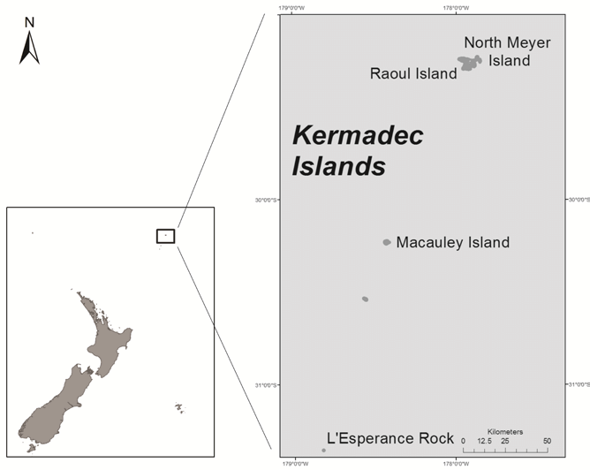
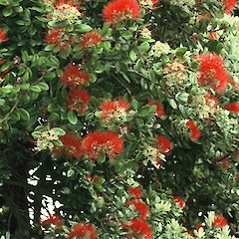
What next?
Comparison with M. kermadecensis (kahika rangitahua)
Notes:
Ngāti Kuri are also interested in comparing the genetic diversity of rātā moehau with that of kahika Rangitahua.
Getting an understanding of the current genetic diversity found in kahika Rangitahua could help inform its management plan

Slide 16
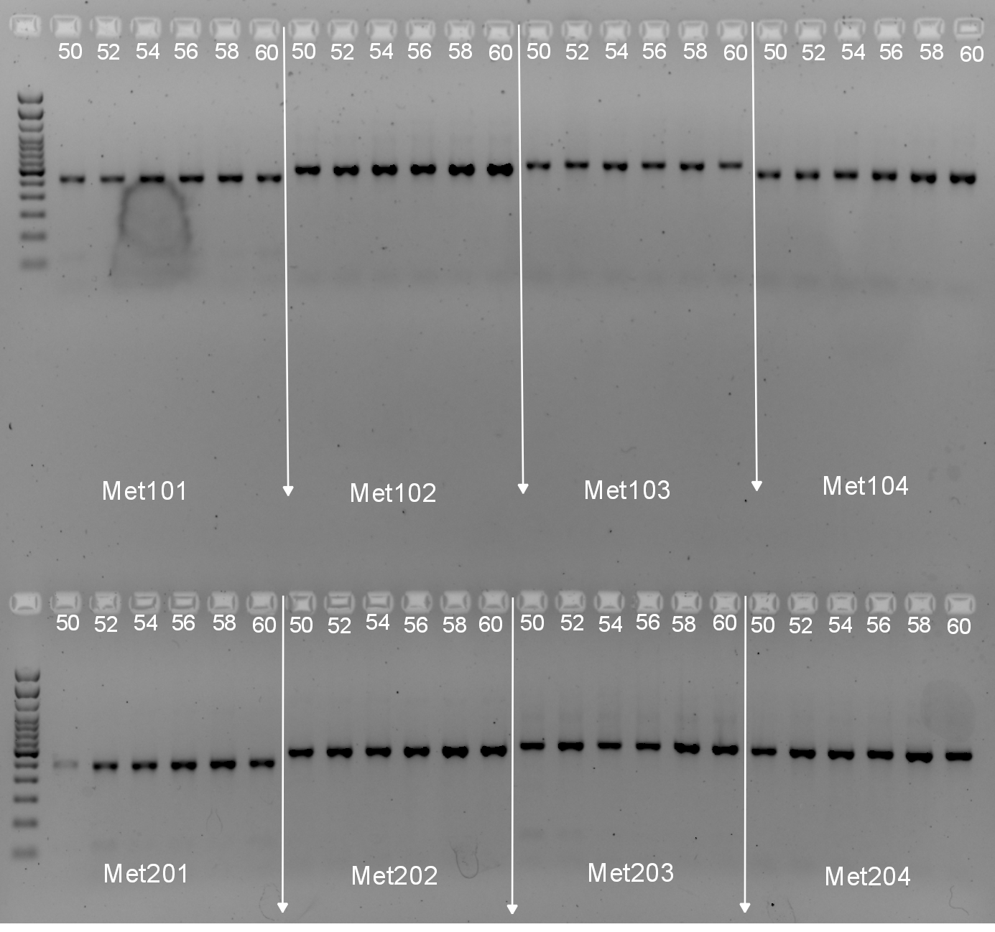
What next?
Design markers from each chromosome
Notes:
We have already designed a set of markers for amplicon sequencing based on the draft genome that we are testing across the genus
Test the markers we have developed based on the draft genome

Slide 17
Two species, allopatric
M. Kermadecensis: dominant on Rangitāhua:
H_{O}= 0.23, f=0.00
M. Bartlettii about 12 in the wild: H_{O}= 0.59, f=0.03
Differences in the diversity show up in a UPGMA tree of pairwise allele differences
M. kermadecensis
M. barlettii

Slide 18
These species share very few if any alleles
If we use distance metrics that account for the sequence divergences among alleles we get quite a different perspective
M. barlettii
M. kermadecensis

Slide 19
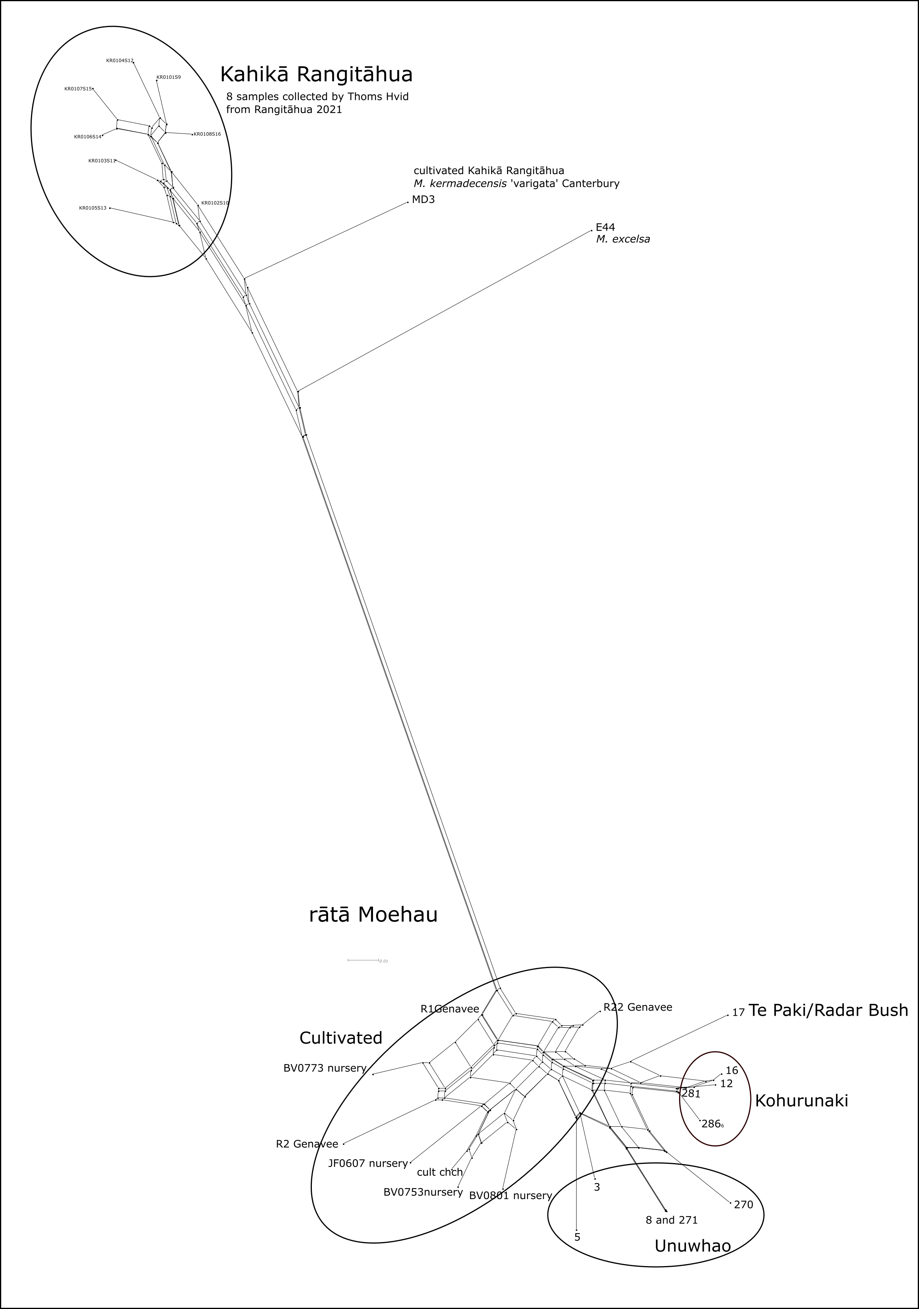
Cultivated M. bartlettii seem to contain diversity no longer in the wild and don’t seem to be clones
Notes:
Want to include more samples of other Metrosideros

Slide 20
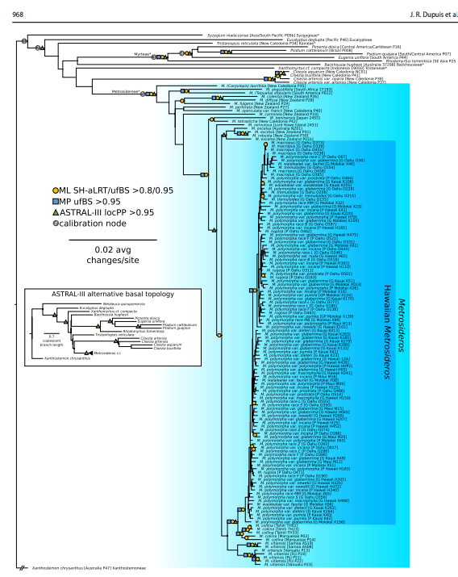
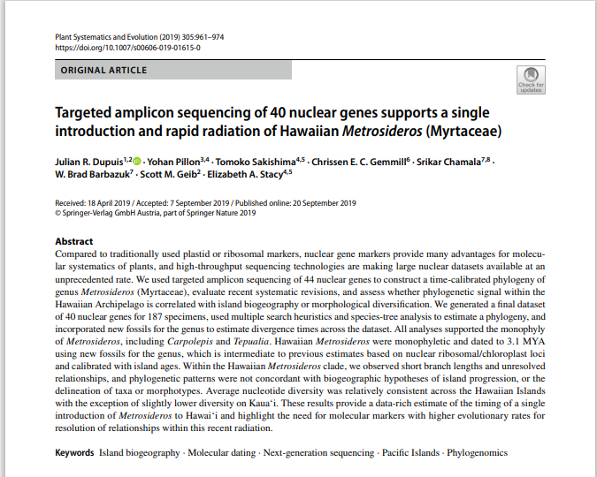
Given our results based on 40 nuclear markers and extensive specimen sampling across the Hawaiian Islands, however, it is clear that adding more genes derived from the same approach will not resolve the relationships in this group. Within the archipelago, we observed no well-supported phylogenetic structure concordant with taxonomic or morphotype boundaries, island of origin, or any other axes of variation (e.g., glabrous vs. pubescent leaves). Observation of genetic diferentiation across islands (Percy et al. 2008) and taxa (Stacy and Sakishima 2019) through other approaches suggests that these low-copy nuclear markers apparently lack the resolution needed for fine-scale population-level analysis.

Slide 21
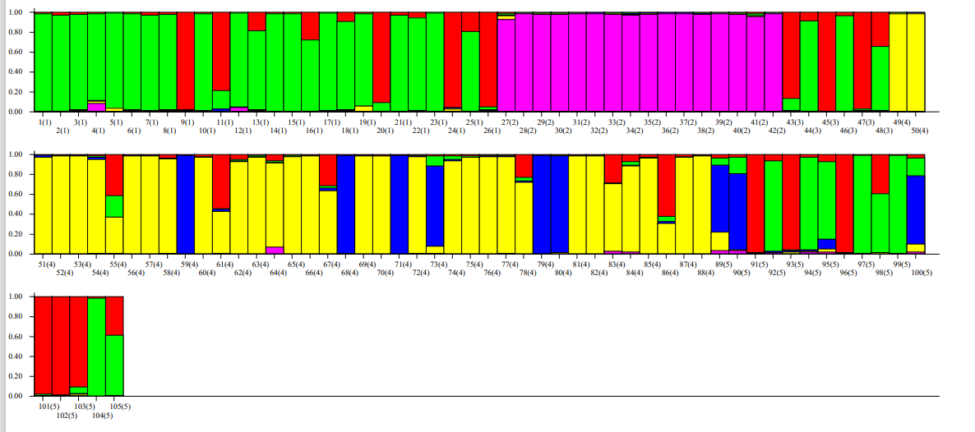
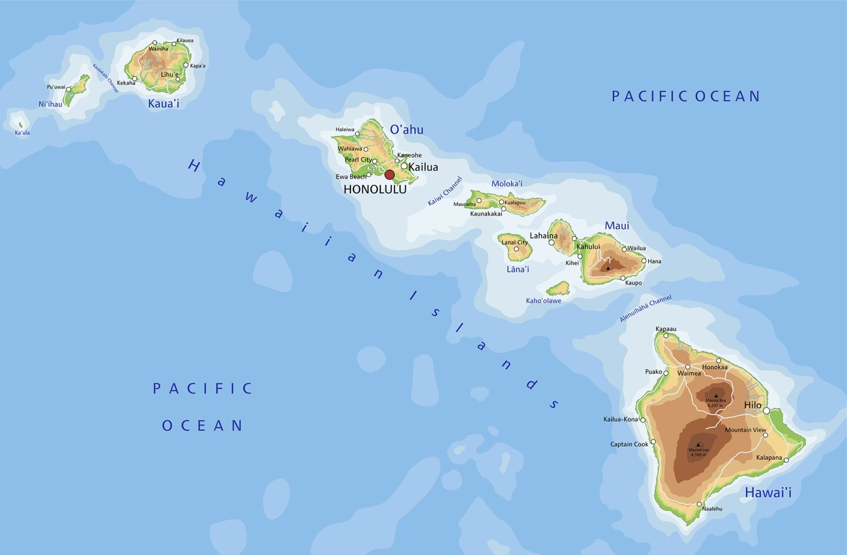
… not if you analyse the data as alleles
Kaua’i
O’ahu
Moloka’i
Maui
Hawai’i

Slide 22
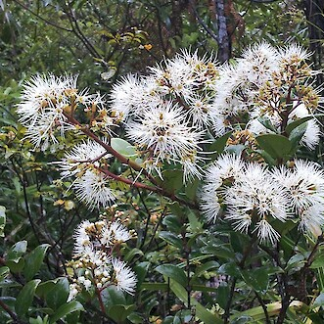
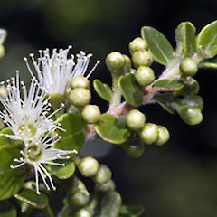
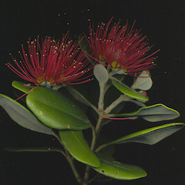
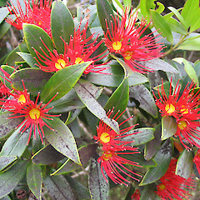
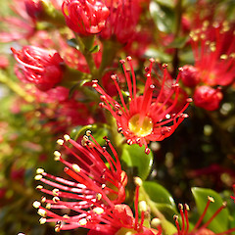
What next?
M. albiflora M. kermadecensis M. perforata
Population genetics of other Metrosideros
M. albiflora
M. excelsa (pohutukawa)
M. excelsa M. umbellata M. carminea
Colin Ogle, Gillian Crowcroft, John Barkla, Jeremy Rolfe sourced from NZPCN Licence: CC BY-NC
Notes:
Predicetd to be most at risk of myrtle rust as their entire distribution is in the area that myrtle rust is predicted to thrive

Slide 23
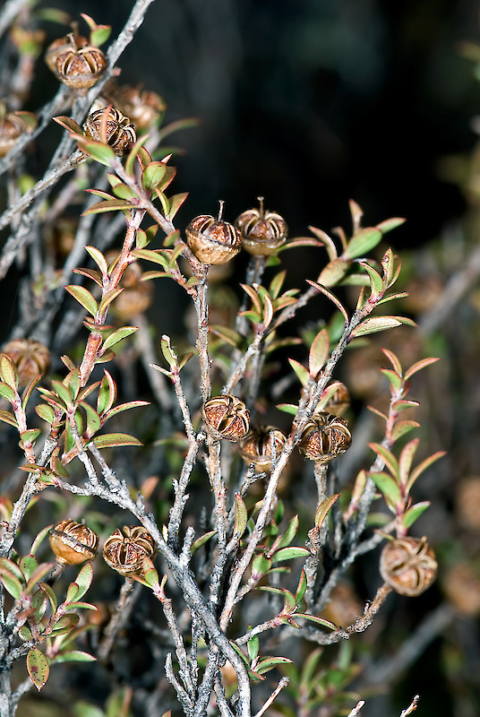
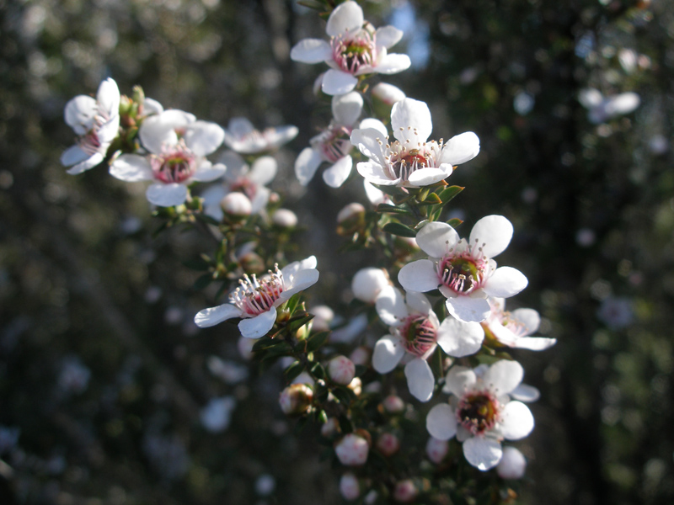
What next?
Resistance to myrtle rust

Slide 24







Kia ora|thank you
Ngāti Kuri
Genomics Aotearoa
Bioheritage Challenge

